Slide 1
Screenshots for Mouse Gut-Brain Axis RNA-seq GEM

Slide 2

Terms of Use

Slide 3
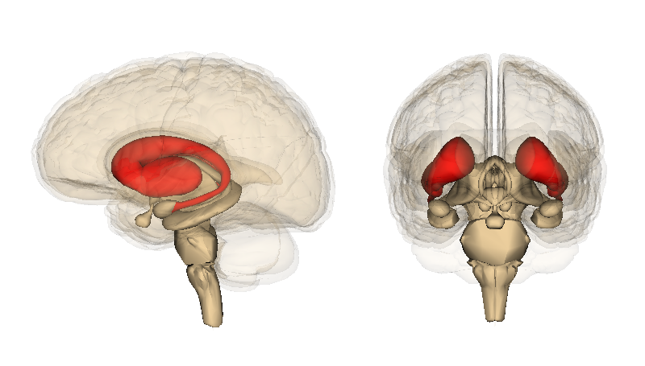
Striatum
Image from commons.wikimedia.org

Slide 4
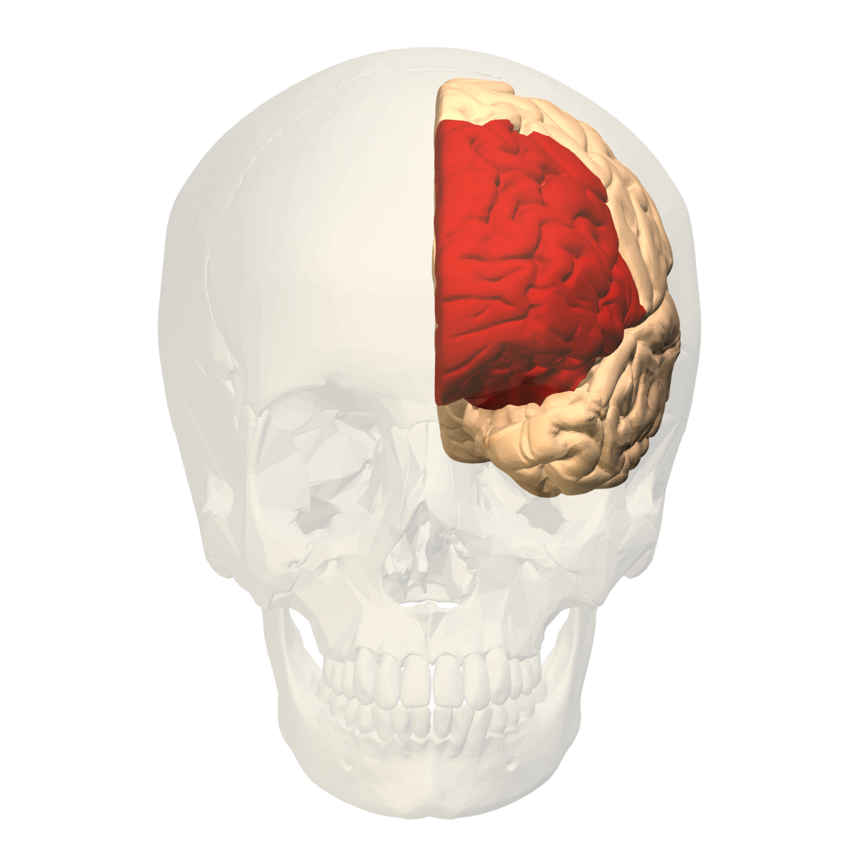
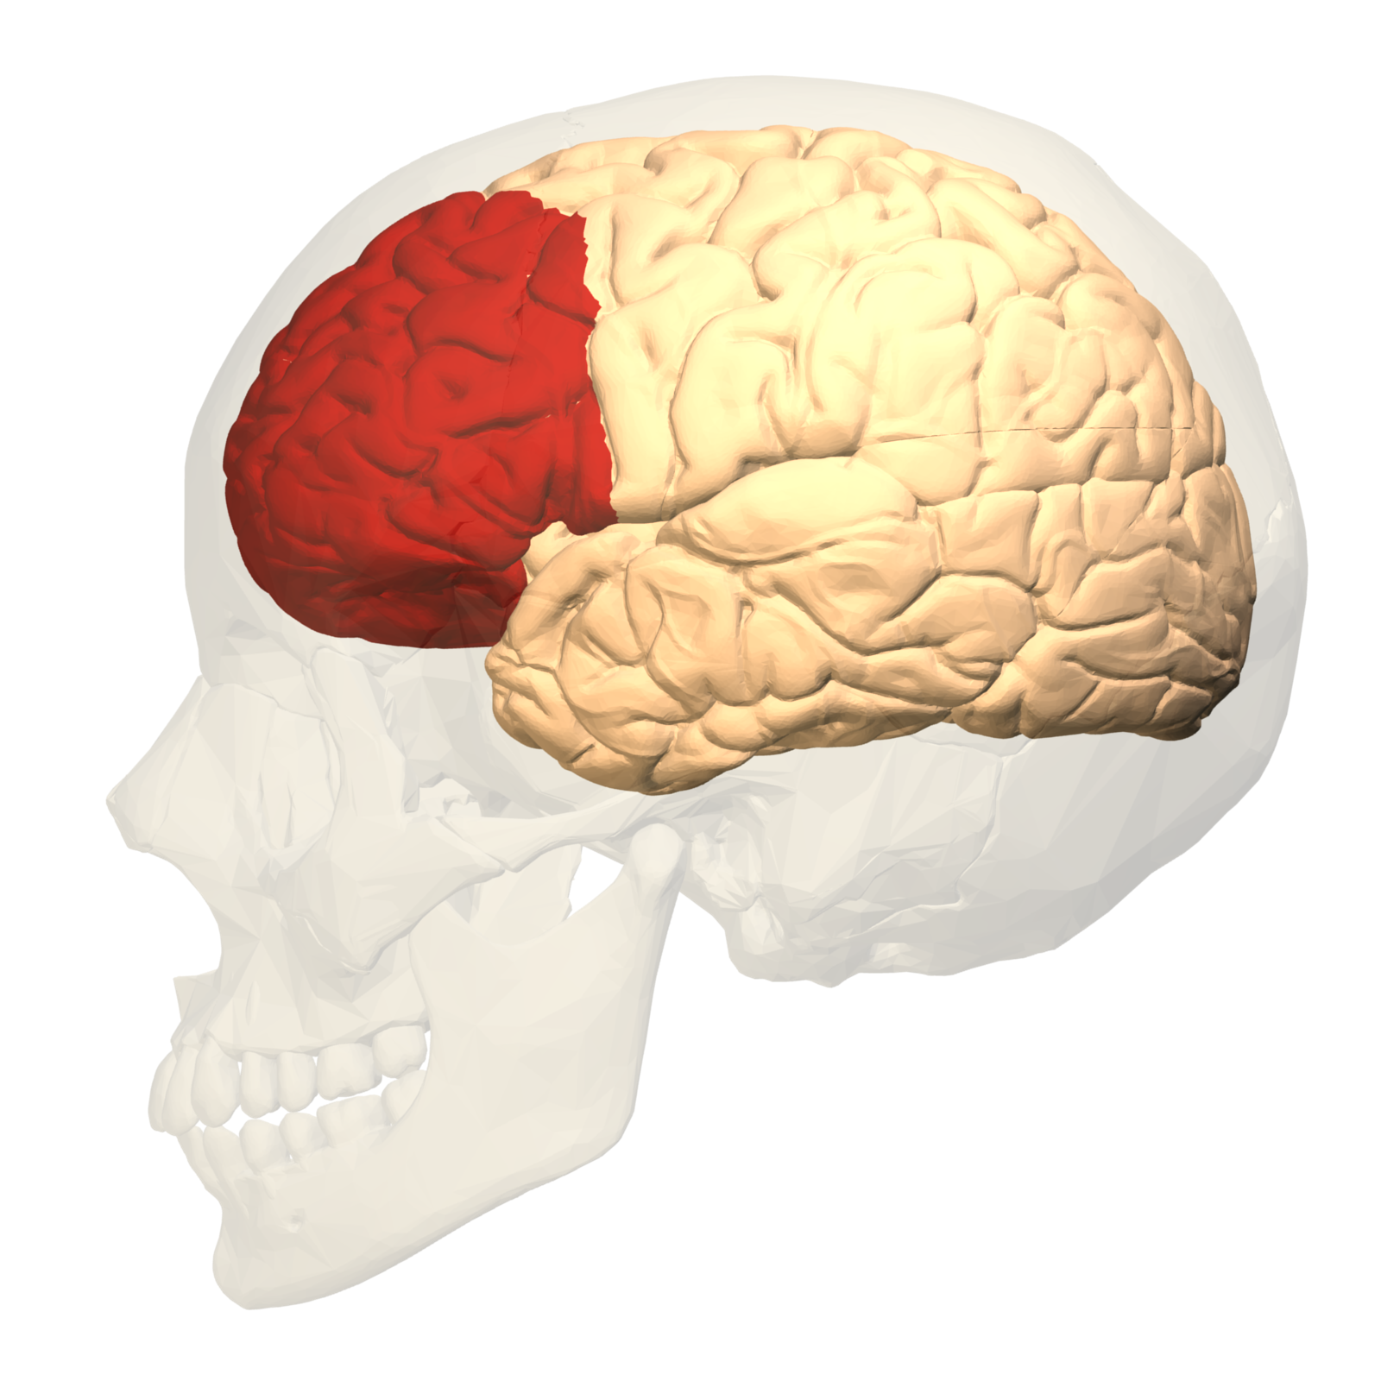
Prefrontal Cortex
By Polygon data were generated by Database Center for Life Science(DBCLS)[2]. - Polygon data are from BodyParts3D[1], CC BY-SA 2.1 jp, https://commons.wikimedia.org/w/index.php?curid=32490636

Slide 5
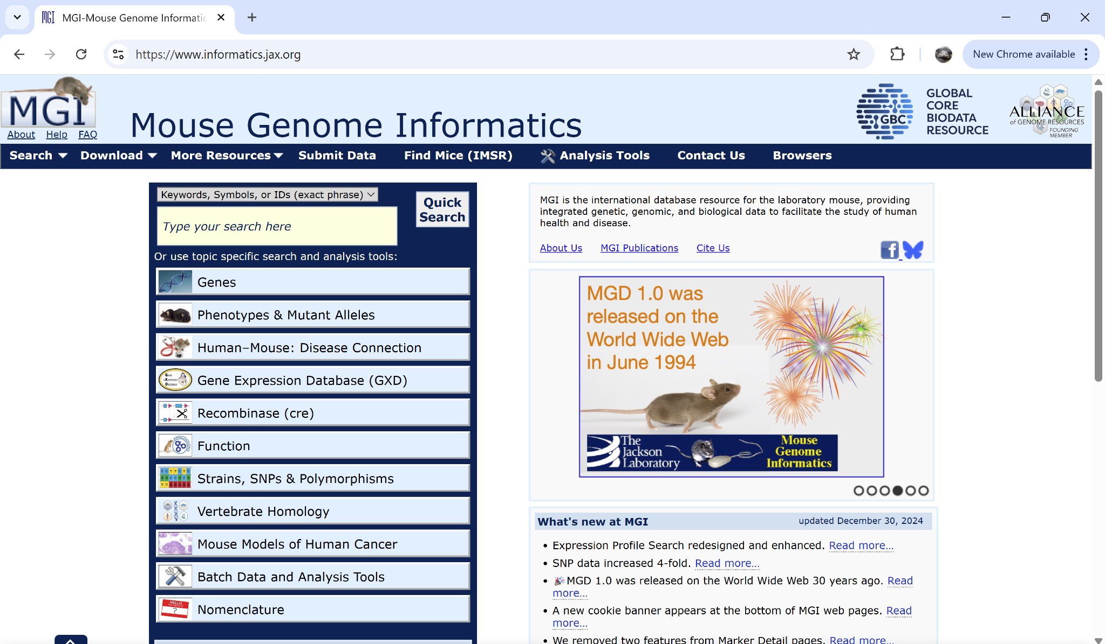

Slide 6
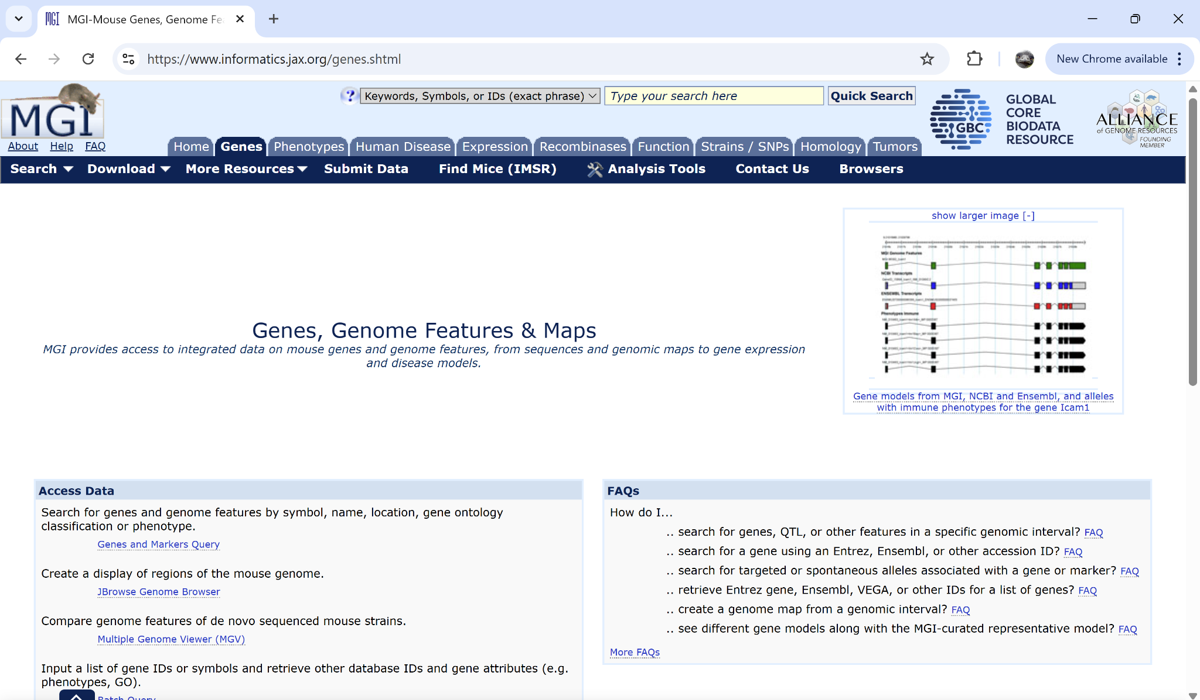

Slide 7
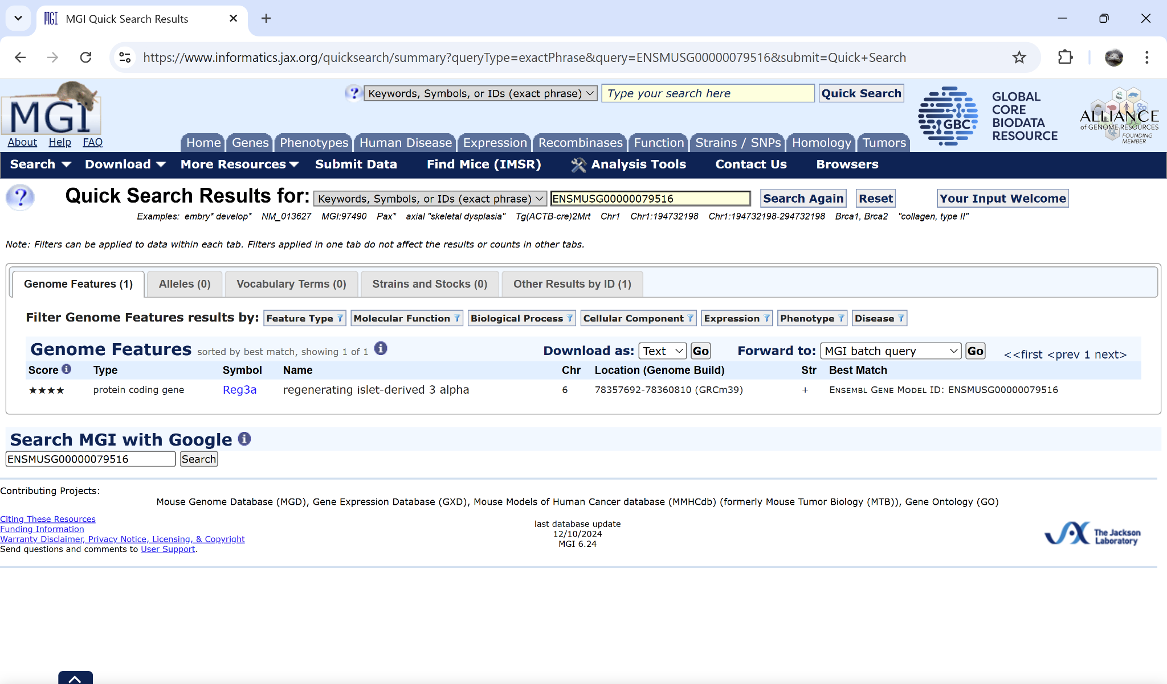

Slide 8
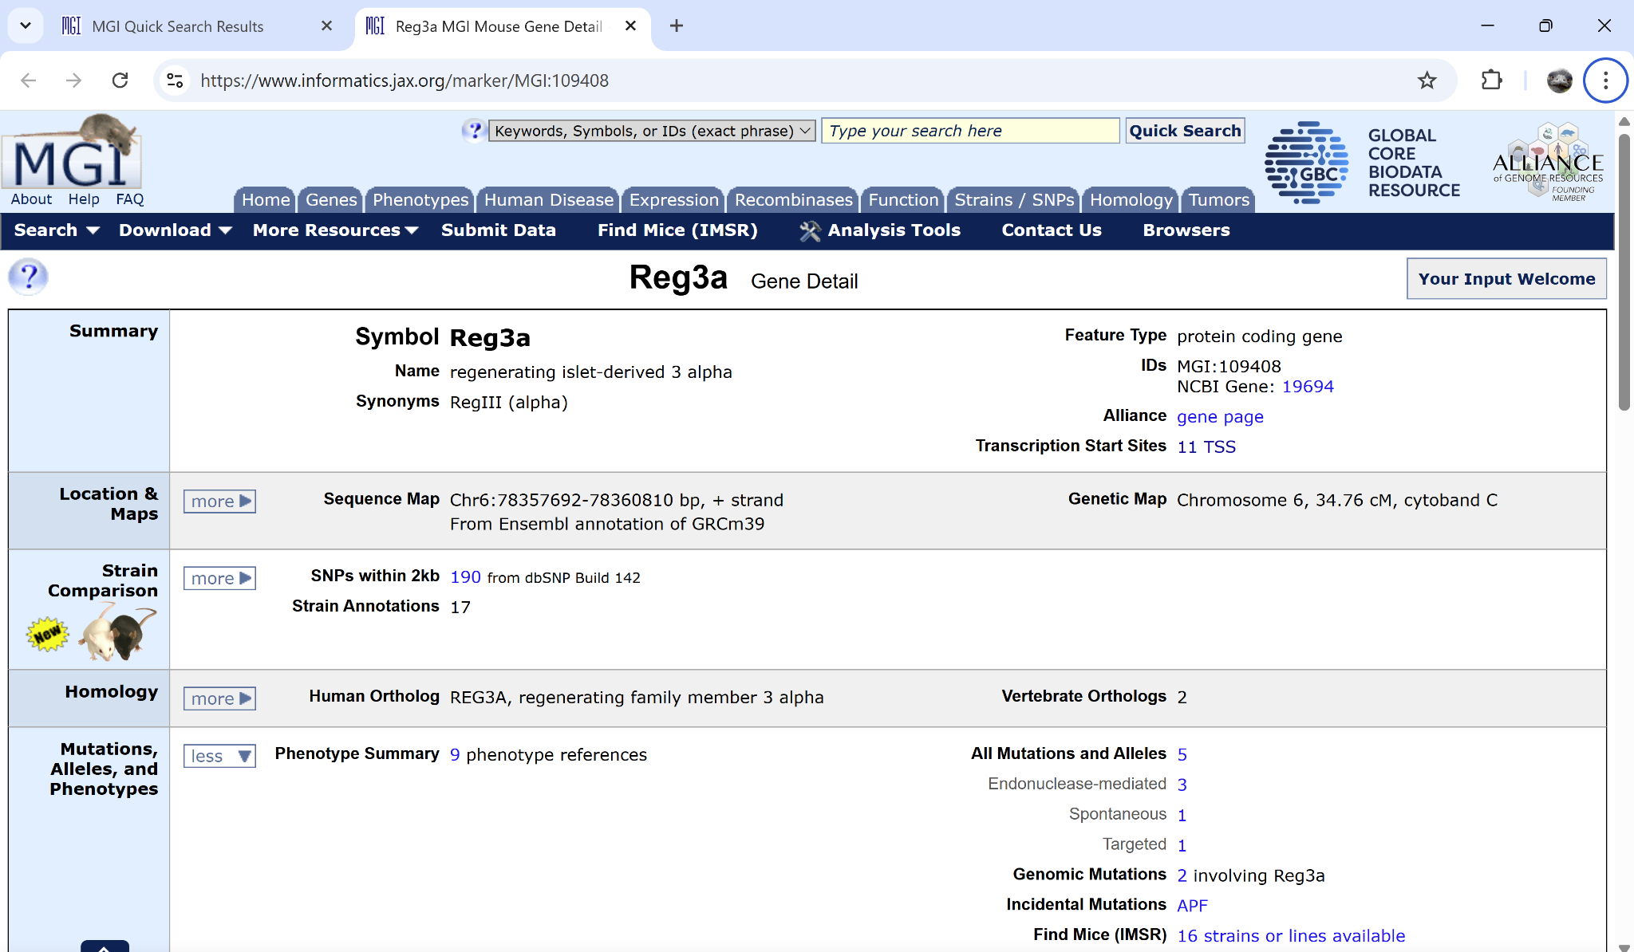

Slide 9
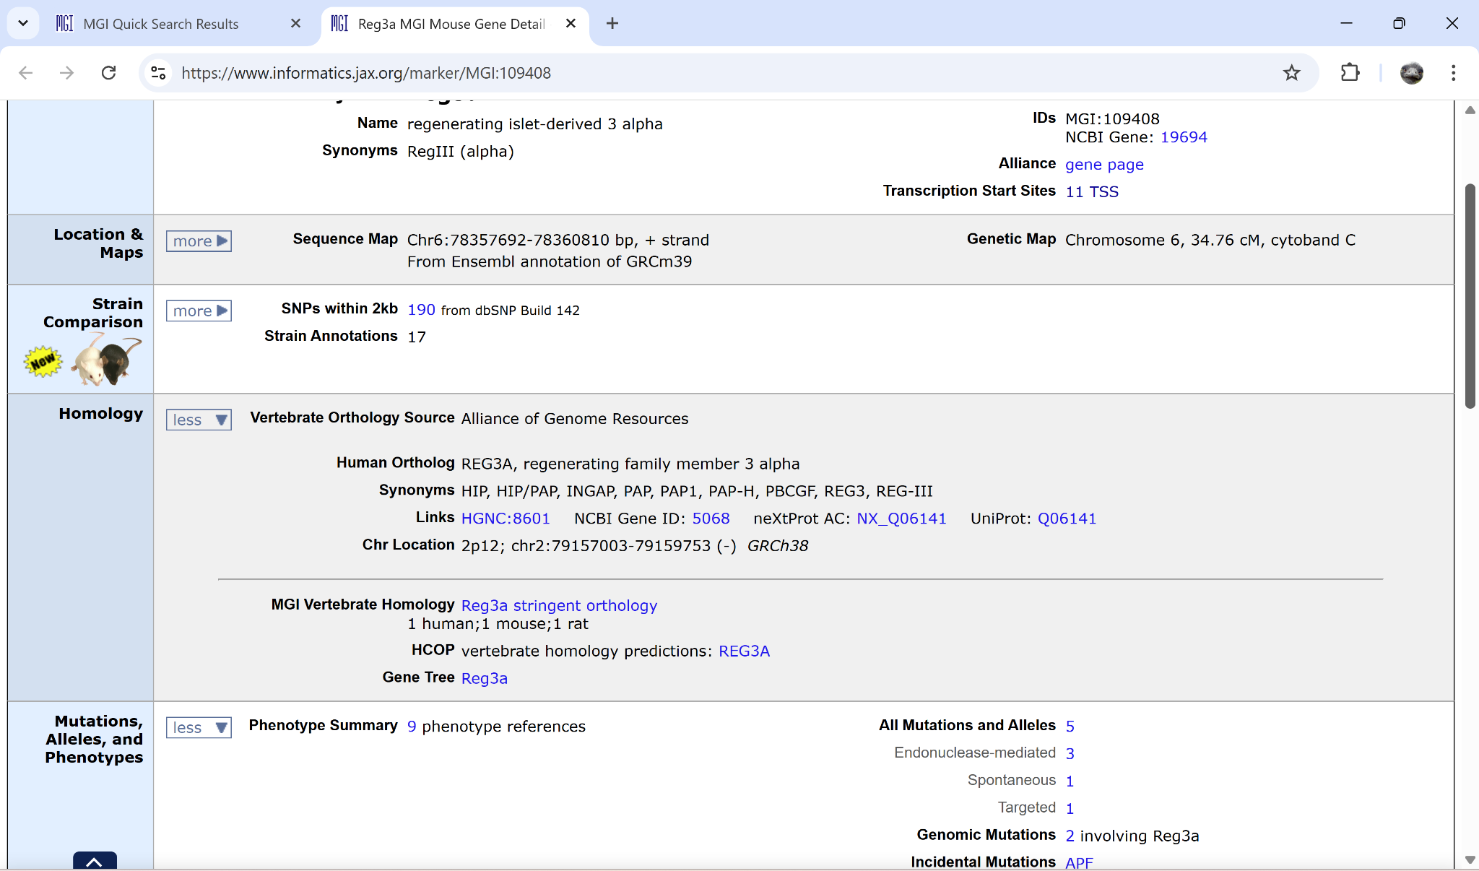

Slide 10
